Slide 1
Case Study 2
Group 2 – Saijal Shankar, Saumya Gupta, Rut Cholera, Yash Rohilla, Samarth Bhatt

Slide 2
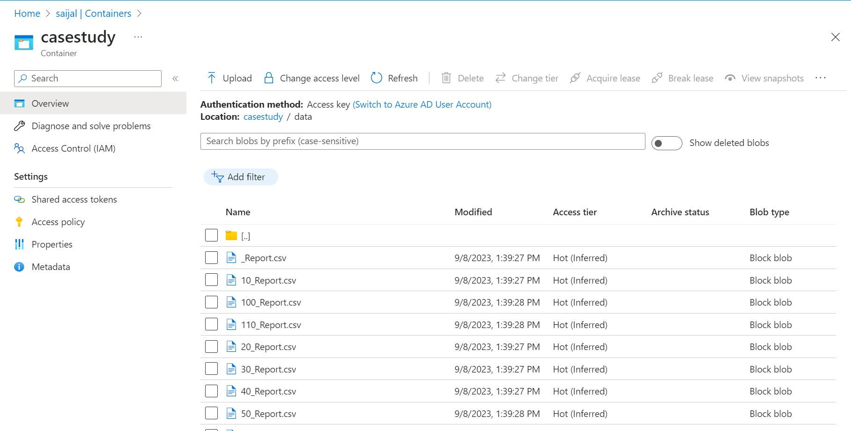
Container where the files are stored

Slide 3
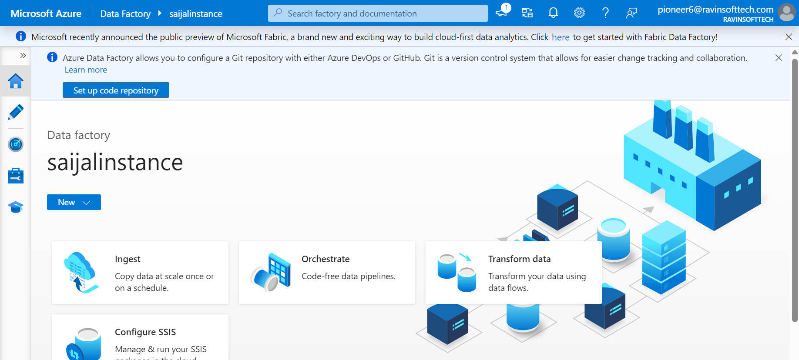
Go to azure data factory

Slide 4
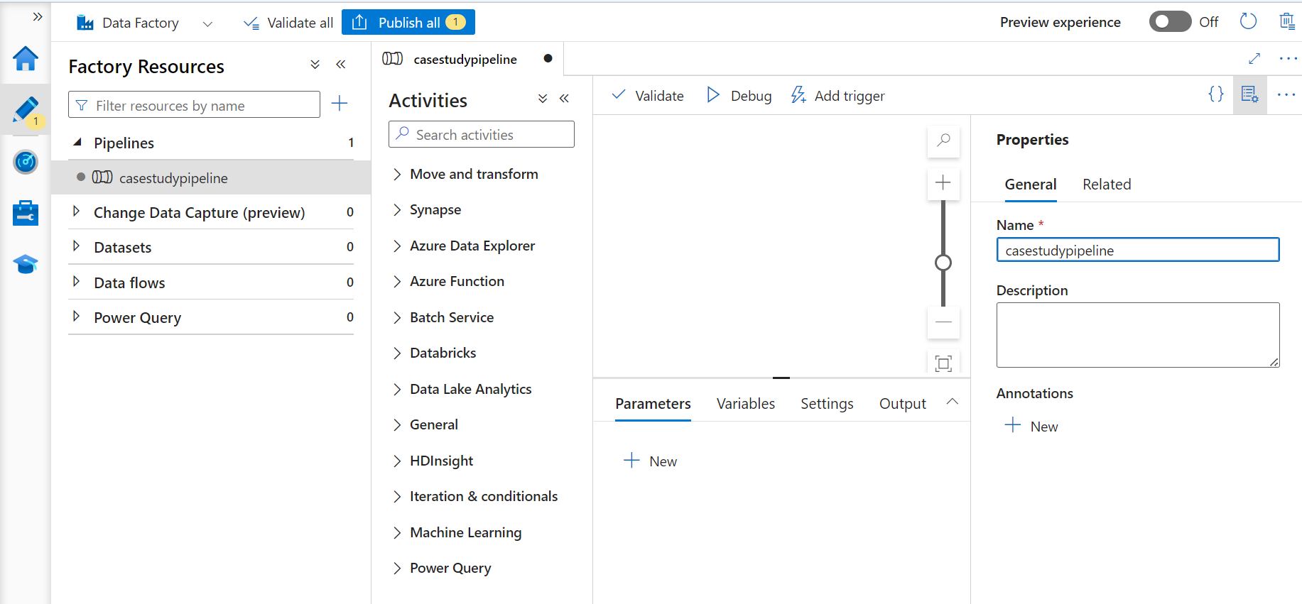
Navigate to author menu and create new pipeline

Slide 5
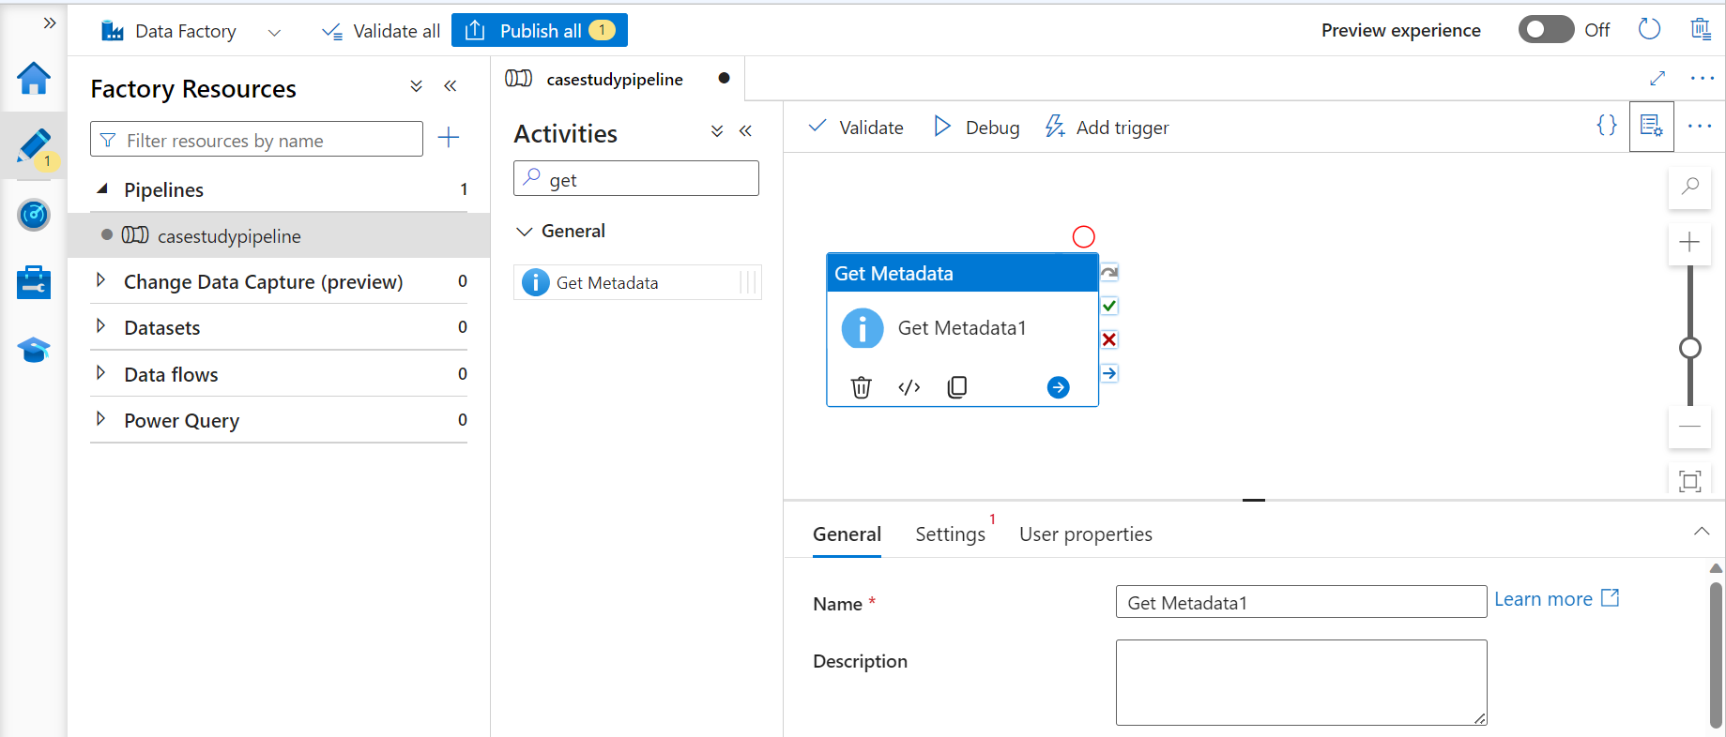
First activity performed is getMetadata activity

Slide 6
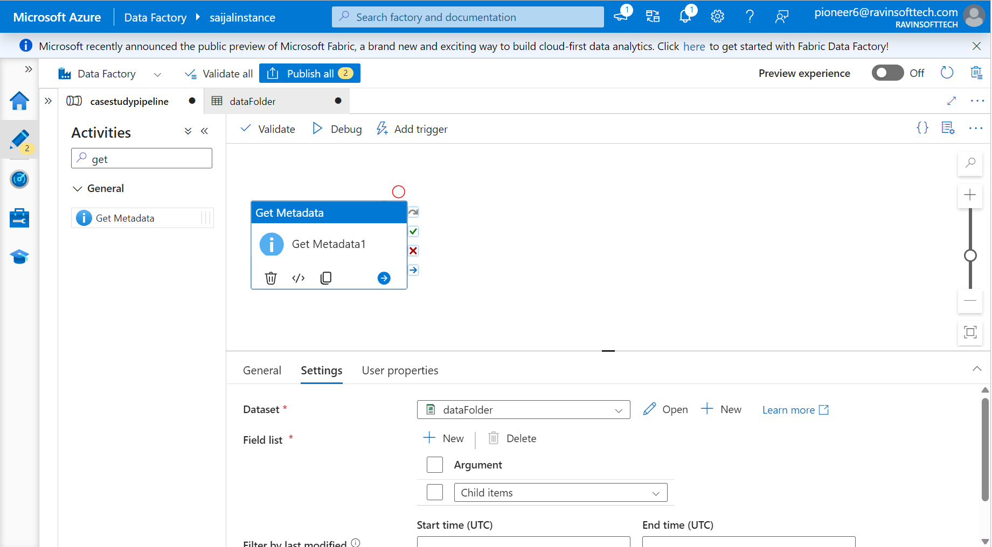

Slide 7
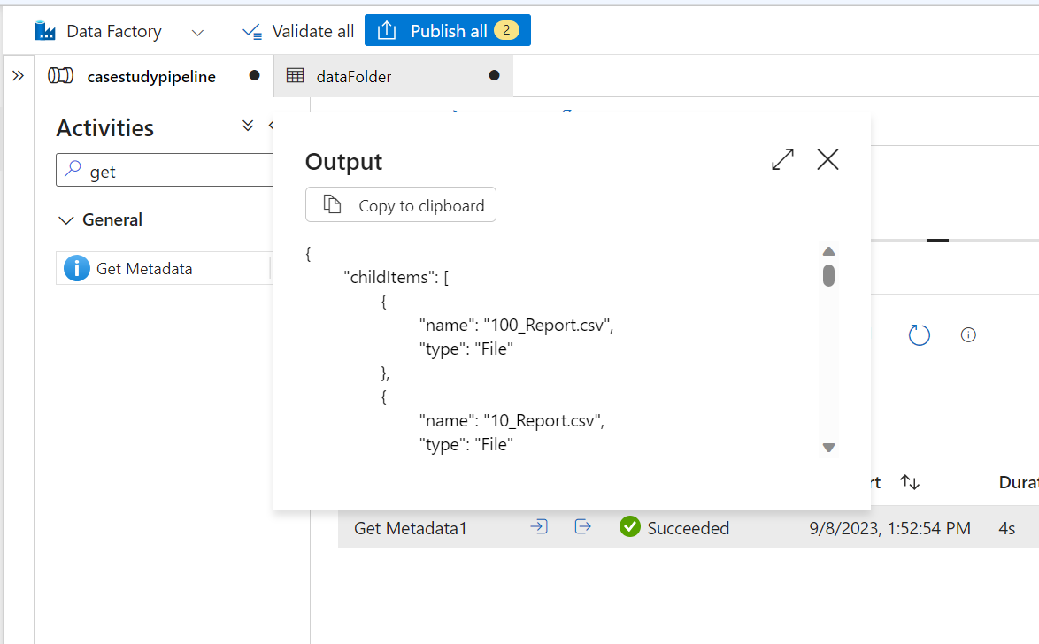
getMetadata Activity

Slide 8
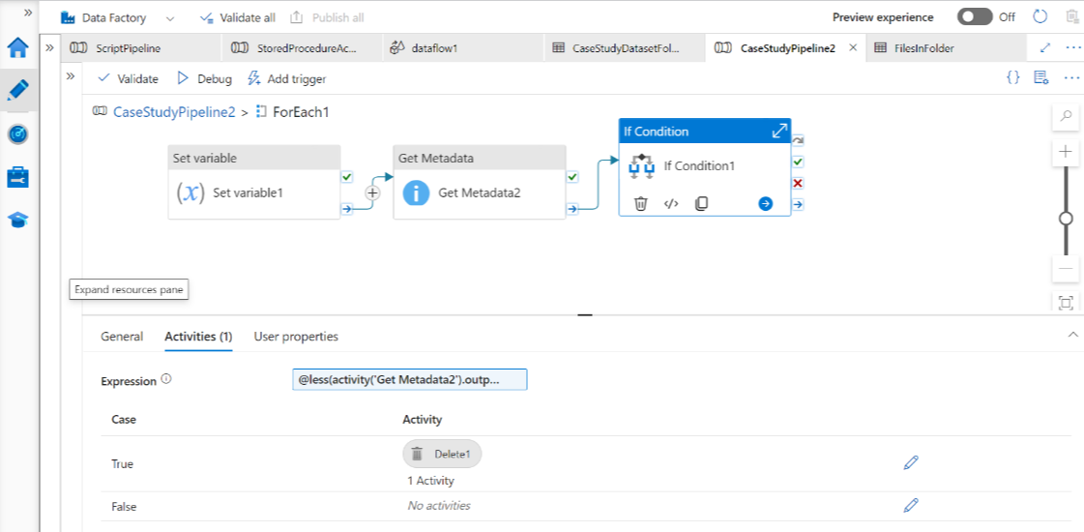
forEach Activity

Slide 9
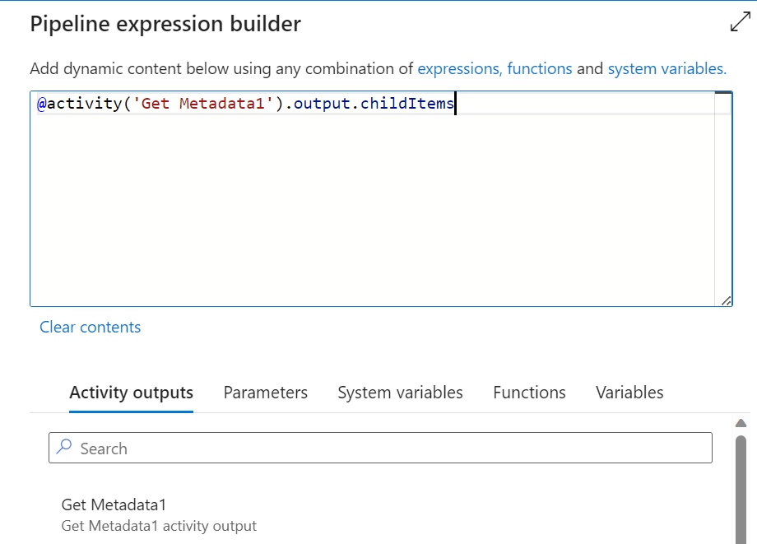
To get child items forEach activity

Slide 10
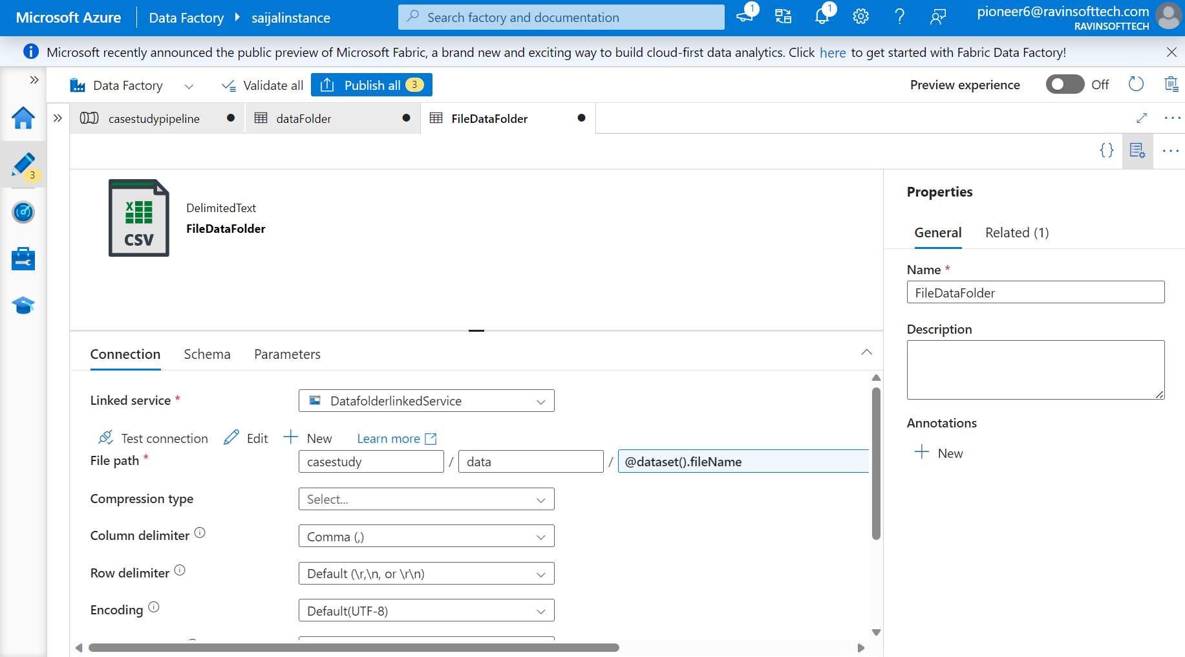
To fetch the files dynamically

Slide 11
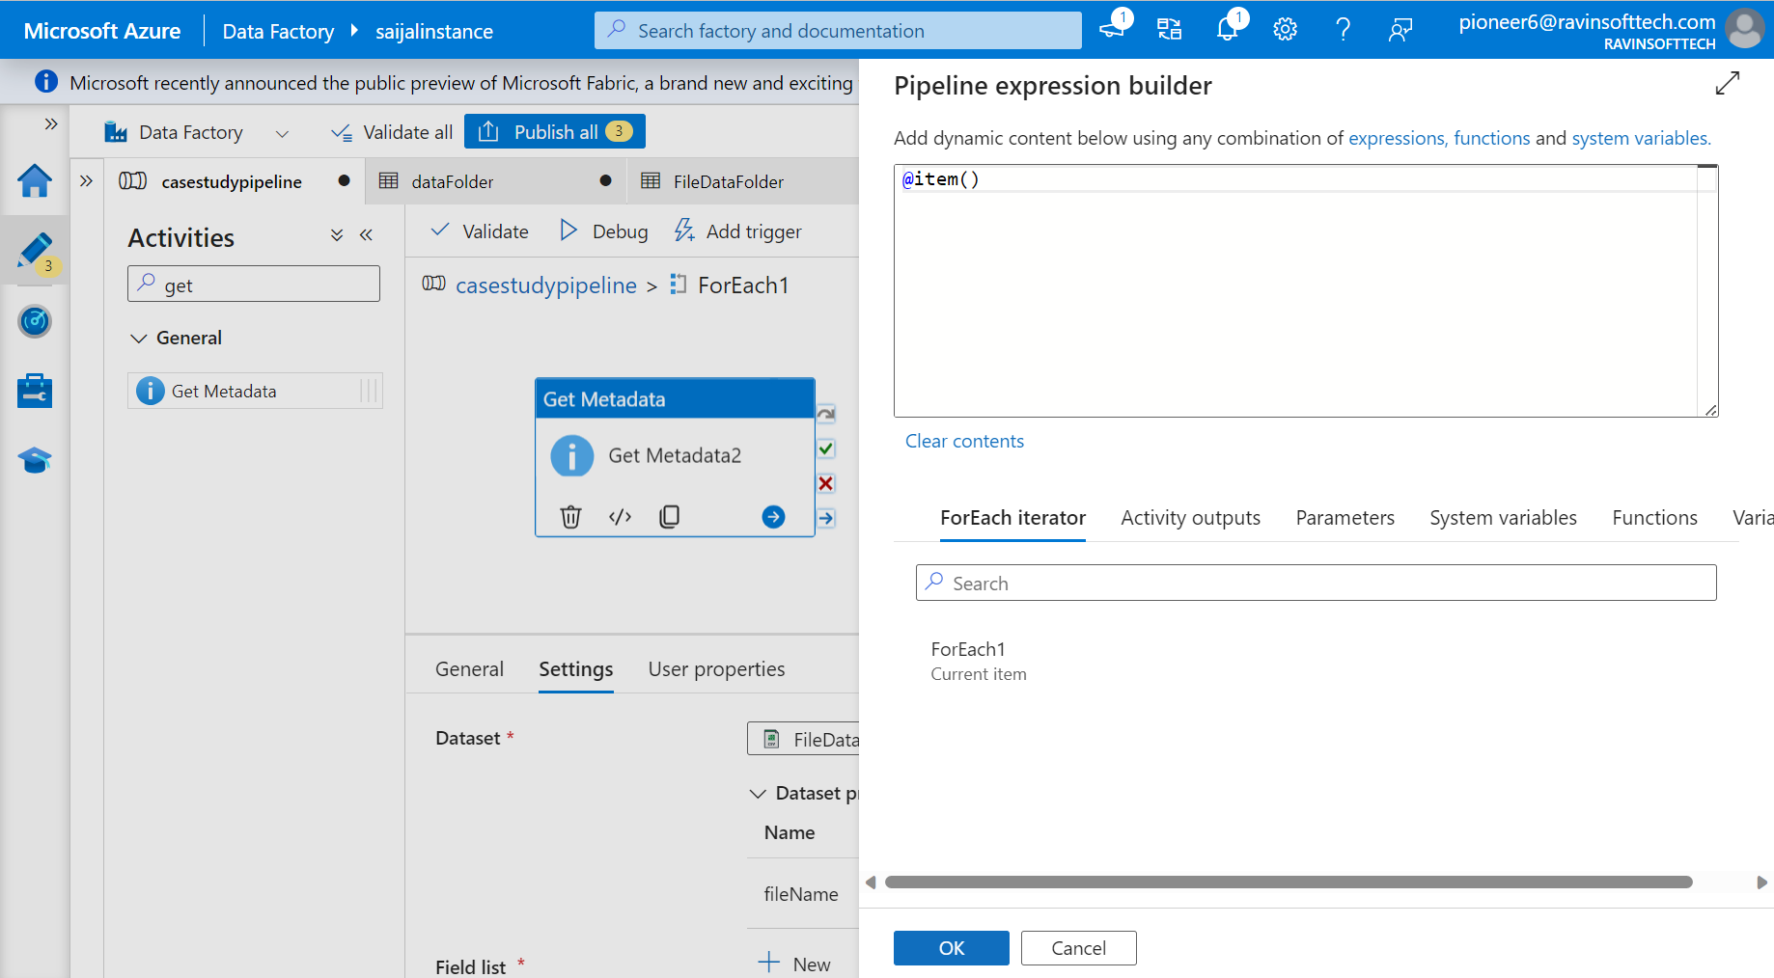

Slide 12
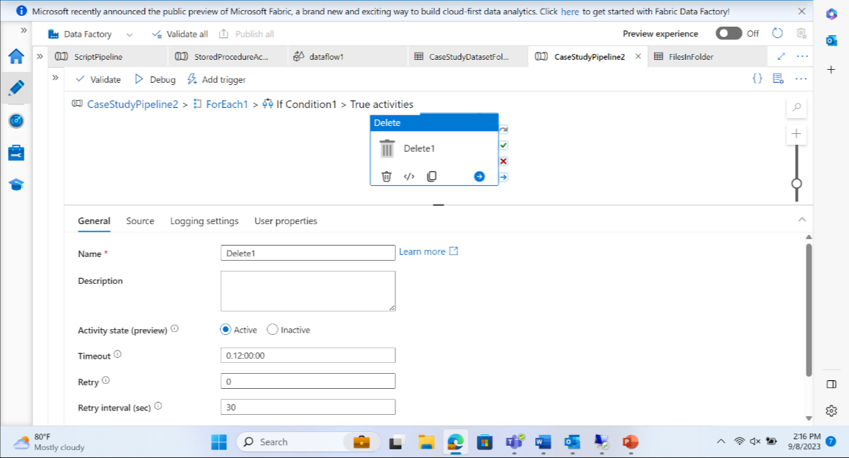
If activity to delete the files with size < 4kb

Slide 13
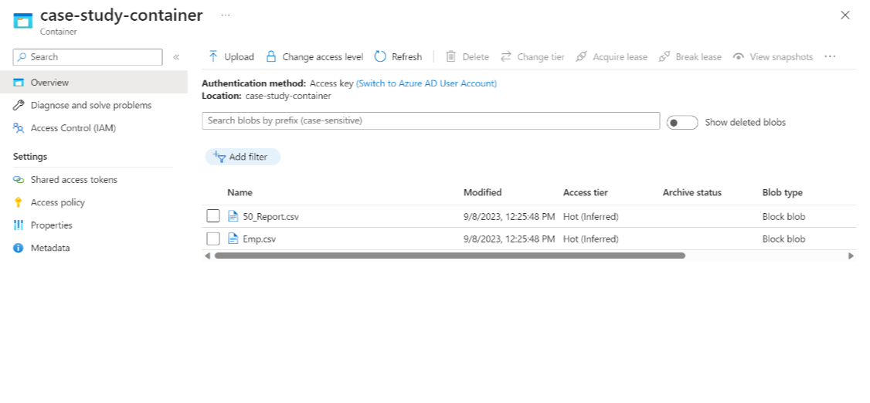
Results after deleting the files with size <4 kb

